Slide 1
CRASH ALART SYSTEM
Under guidance of
Mr/Dr. Faculty,
Designation,
BIT,
Sathy.
Student 1 (211AU516 & SHREEHARI P)
Student 2 (211AU514 & SANJAY R)
Student 3 (211AU508& INDRA PRASATH A)
Student 4 (201AU130 & THRISHA R)

Slide 2
Abstract
Shock sensor is used to detect accident. ... Through GSM the exact location of the accident location is obtained and through GSM module send an alert message to the register mobile number and police station. And information is sent to the near Police Stations, family members, friends etc which is triggered when the bike senses a fall, enters crash alert mode within 180 seconds and notifies the rider’s emergency contacts with the location of the fall. Accident detection using ultrasonic sensor provides the facility to detect an accident not only in various street situations but also it might perform well under various natural conditions like rains.

Slide 3
Problem Statement Addressed
The proposed Vehicle accident detection system can track geographical information automatically and sends an alert SMS regarding accident. ... So, the police can immediately trace the location through the GPS MODEM, after receiving the information. Then after conforming the location necessary action will be taken

Slide 4
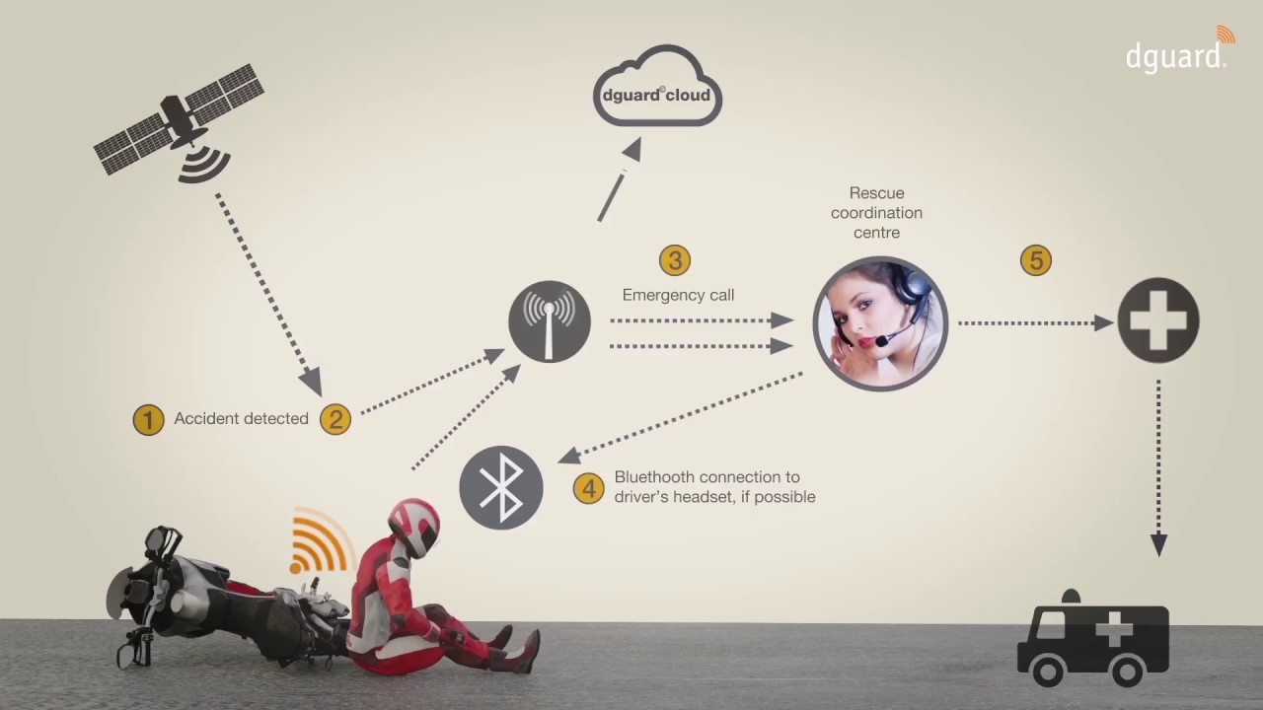
Existing Solution to the Problem Addressed

Slide 5
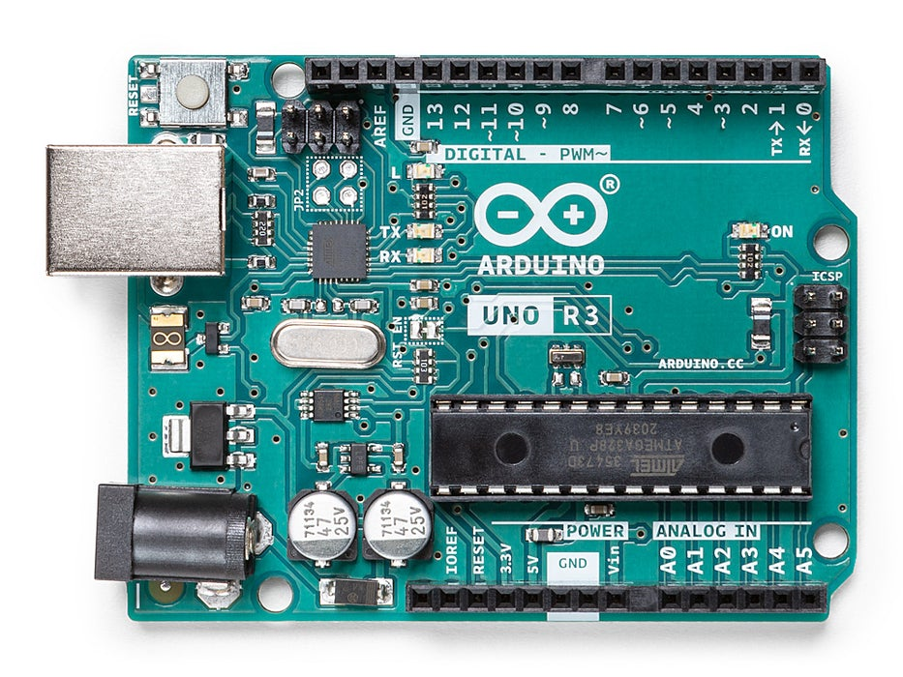
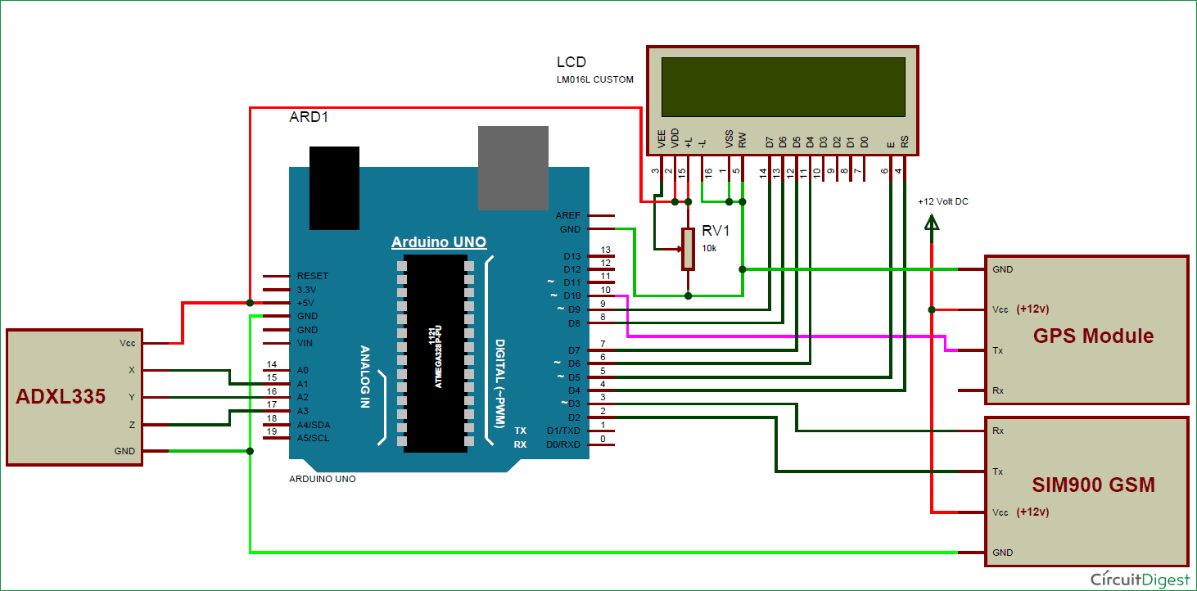
Block Diagram and/or Circuit Diagram

Slide 6
Effective utilization of the Modern Tool & Cloud
Arduino is an open-source electronics platform based on easy-to-use hardware and software. Arduino boards are able to read inputs - light on a sensor, a finger on a button, or a Twitter message - and turn it into an output - activating a motor, turning on an LED, publishing something online.

Slide 7
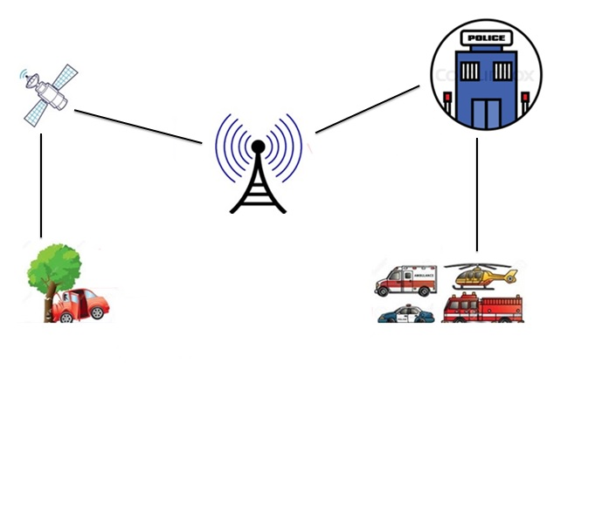
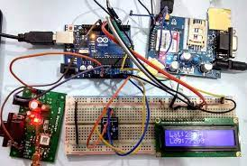
Prototype & Sample Output

Slide 8
Analysis of Results & Discussions
ADVANTAGES OF CRASH ALERT SYSTEM:
This system is an immediate aid system.
Monitors all hazards and threats.
Alert messages are sent to the nearby hospitals and police stations.
It is an affordable system.
Can be used in any kind of vehicle.
The alert message regarding the accident is automatically sent, this system can be used for a social cause.
It does not need any operation manually.

Slide 9
Cost Benefit Analysis (List of Components / Service Used)
(Budget)
S.No | Component Name | Specification (IC number or Range or Value) |  | Total Cost
1 | Accelerometer (ADXL335) | (ADXL335) |  | 600
2 | LCD | 16x2 |  | 300
3 | Breadboard or PCB | - |  | 250
4 | Connecting wire | 15 |  | 150
TOTAL COST |  |  |  | 1300

Slide 10
References
https://ieeexplore.ieee.org/abstract/document/9250904
https://papers.ssrn.com/sol3/papers.cfm?abstract_id=3368089

